Slide 1

Fraud Detection System: A Case Study Report
Delivering actionable insights for enhanced security and risk mitigation in insurance.

Slide 2

1. The Challenge
Combating Fraudulent Claims in Insurance
Insurance companies face significant challenges from fraudulent claims, leading to substantial financial losses and reputational damage. Traditional rule-based systems often struggle to distinguish legitimate claims from sophisticated fraudulent activities.
1
2
3
High Accuracy Detection
Improved Recall
Real-time Simulation
Identify fraudulent claims with precision.
Maximise the capture of fraudulent cases while minimising false positives.
Support investigation teams with immediate insights.

Slide 3

2. Data Landscape
Understanding Our Dataset
Rows: 1000 claims
Key Features Examined:
Columns: 40 initial, expanding to 145 features after encoding.
Customer information: age, occupation, education, relationship status.
Target: fraud_reported (1 = Fraud, 0 = Legitimate).
Class Balance: Highly imbalanced (~25% Fraud vs 75% Non-Fraud).
Policy details: deductible, premium, umbrella limits.
Incident specifics: type, severity, collision type, date/time.
Claim amounts: total, injury, property, vehicle.
Vehicle information: make, model, year.

Slide 4
3. Preparing the Data
Robust Data Preprocessing for Accuracy
To ensure the highest model performance, rigorous preprocessing steps were undertaken to clean, transform, and enhance the raw dataset.
01
02
03
Irrelevant Data Removal
Feature Engineering
Handling Missing Values
Columns such as policy_number, insured_zip, incident_location, and _c39 were eliminated to reduce noise and prevent data leakage.
Date columns were converted into meaningful derived features: year, month, and day_of_week for better temporal insights.
Missing categorical values (represented by ?) were systematically replaced with 'Unknown' to maintain data integrity.
04
05
Categorical Encoding
Target Variable Mapping
One-Hot Encoding was applied to all categorical variables, expanding the dataset to 145 columns, ready for model input.
The fraud_reported target variable was mapped to a numerical 1/0 format for compatibility with machine learning algorithms.

Slide 5
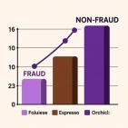
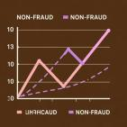
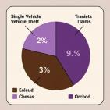
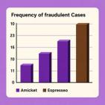
4. Initial Insights
Exploratory Data Analysis Highlights
Exploratory Data Analysis revealed critical patterns and imbalances within the claims data, guiding our model development.
Fraud Distribution: Only 25% of claims were fraudulent, highlighting significant class imbalance.
Claim Amounts: Fraudulent claims displayed higher variability in total claim amounts.
Incident Types: Fraud was more prevalent in single vehicle accidents and vehicle theft cases.
Auto Makes: Certain brands, like Chevrolet and Dodge, appeared disproportionately in fraud incidents.
Property Damage: Fraudulent claims were frequently associated with "Unknown" property damage responses.

Slide 6


5. Model Performance
Building the Optimal Fraud Detection Model
We evaluated three distinct machine learning approaches to identify the most effective solution for fraud detection.
75%
73%
76%
Logistic Regression (Baseline)
Random Forest
Random Forest + SMOTE (Final)
Accuracy: 75%ROC-AUC: 0.60Fraud Recall: 0 (failed to detect fraud)
Accuracy: 73%ROC-AUC: 0.82Fraud Recall: 0.10 (improved, but still low)
Accuracy: 76%ROC-AUC: 0.77Fraud Recall: 0.27 (caught more fraud cases)Fraud Precision: 0.52 (about half of flagged frauds were true frauds)
Key Takeaway: While ROC-AUC slightly decreased, the significant improvement in Fraud Recall (from 0.10 to 0.27) is crucial for fraud detection, where flagging more potential frauds outweighs a minor dip in overall accuracy.

Slide 7
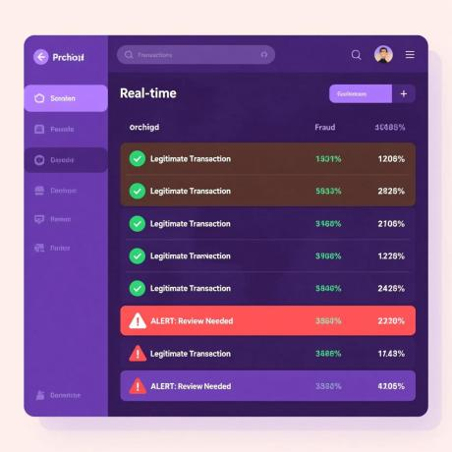
6. Live Application
Simulating Real-Time Fraud Monitoring
A functional simulation was developed to demonstrate how the model could operate within a live fraud monitoring pipeline, providing immediate alerts for suspicious claims.
Each incoming claim is assigned a fraud probability score by the model.
If fraud probability ≥ 0.5: ⚠️ ALERT triggered, indicating a high-risk claim for immediate review.
Otherwise: ✅ Legitimate Transaction, proceeding without interruption.
Transaction 498:

Slide 8


7. Strategic Implications
Insights & Business Recommendations
Our analysis provides actionable insights for refining fraud detection strategies and optimising resource allocation.
Imbalanced Data Mitigation
Key Predictors
High-Risk Patterns
Focus on claim amounts, incident severity, property damage details, and specific auto makes/models as strong indicators of fraud risk.
Watch for unusual claim amounts relative to incident type, missing/unknown values in critical fields, and disproportionate involvement of certain auto brands.
Leverage techniques like SMOTE or cost-sensitive learning to enhance detection of rare, high-impact fraud cases.
Business Actions: Prioritise high-risk claims for manual review, flag suspicious patterns, and integrate model outputs into real-time investigation dashboards.

Slide 9
8. Project Conclusion
Deliverables & Future Outlook
✔ Cleaned & processed dataset
This project successfully combined:
✔ Comprehensive EDA report with visuals
Data-driven insights from detailed EDA.
✔ Multiple fraud detection models (baseline + advanced)
Robust machine learning models (Random Forest + SMOTE).
✔ Real-time fraud detection simulation function
A practical real-time monitoring simulation.
✔ Fraud investigation dashboard visuals
This comprehensive Fraud Detection System offers a significant advancement in identifying and mitigating financial risks for insurance companies.
✔ Final report with insights & recommendations

